Slide 1
State machine to circuit

Slide 2



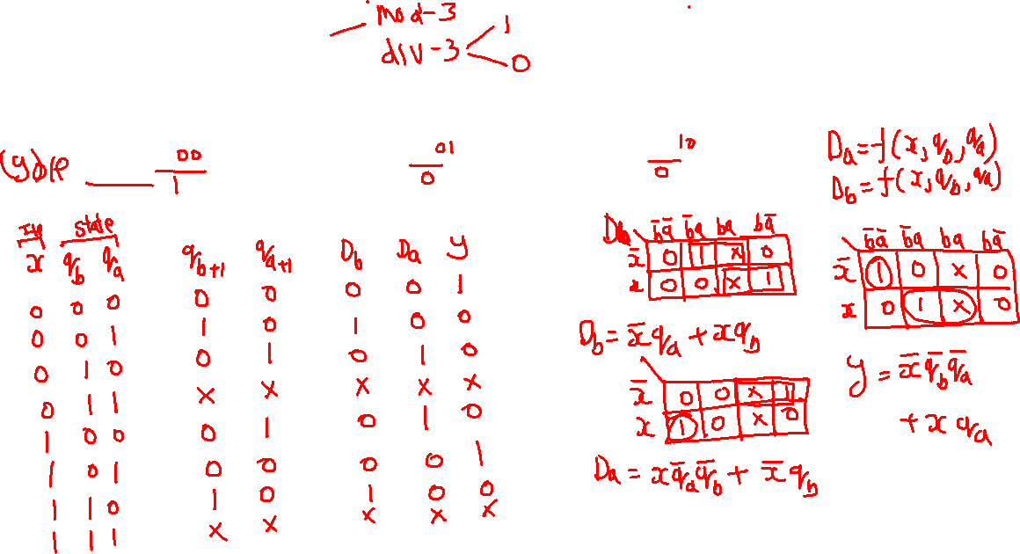





Mod-3 circuit

Slide 3
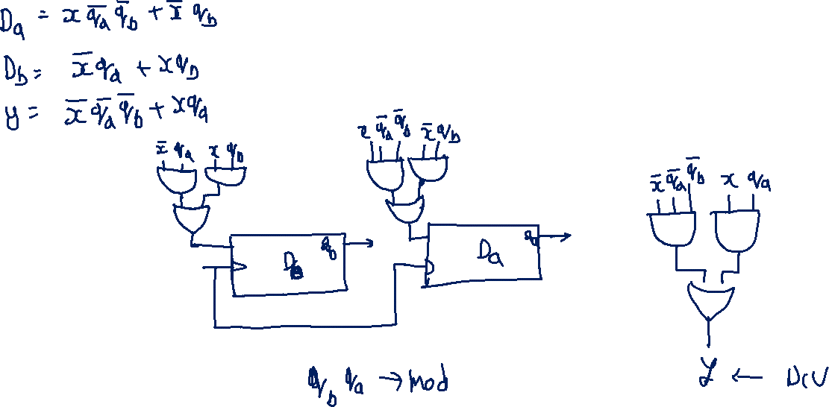

Slide 4










Mod-3 + Divide-3 circuit

Slide 6
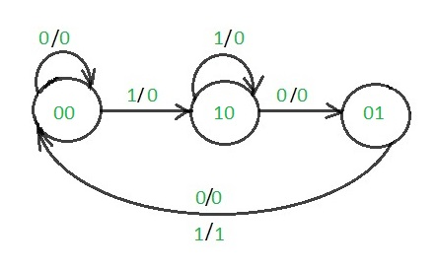

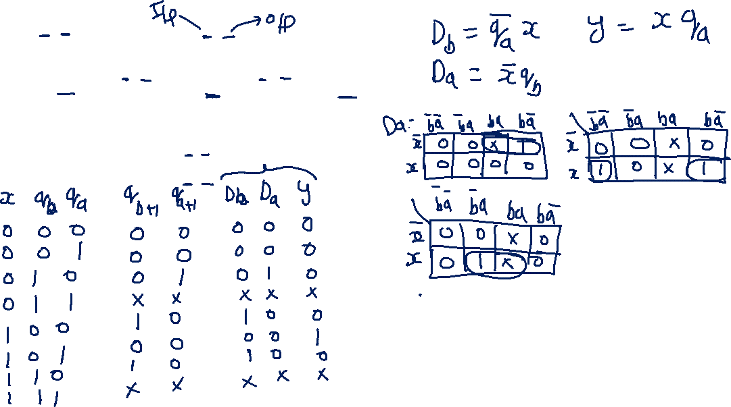
101 pattern detector circuit

Slide 7
